Slide 1
Representing information CSCI 5839 Fall 2021
Notes:
Book page from Edward Tufte, Envisioning Information

Slide 2
The problem
How to represent information to the user
How we often encounter it: “Ack! Should this be a chart, a map, a timeline??”
or “These are social media posts, so they should be in a timeline.”
How we should think about it: What is the user trying to accomplish and how can we put that information in front of them?

Slide 3
Why discussing in this class?
Graphical representations are a core part of most interactive systems
Most of the time we need to show “stuff” in our user interface
It’s important to tie the representation of information to user’s goals
“Human-centered information design”

Slide 4
Human-centered information design
Activity
What is the user trying to do?
Often about making a decision
What information do they need to make this decision?
How can we optimize finding this info and making comparisons?
Notes:
This is really about supporting activity, just as we have elsewhere in this class.
Always come back to “what is someone doing?”

Slide 5
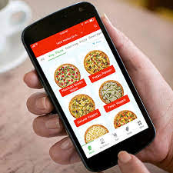
What data is meaningful?
Let’s say we have a data set of pizza places in Boulder
What questions might users have about this data set?
What choices might users make based on this data?
Notes:
We can also start by talking about data, but instead let’s start with questions. Any time you are able to tie this back to user experience, the better

Slide 6
Pizza questions

Slide 7
Data about pizza
Menu items
Ratings
Style of pizza
Delivery
Fees (delivery)
Hours
Location
Health code compliance

Slide 8
Questions that a pizza user might have
What’s the cheapest large pizza?
What pizza tastes the best?
What’s the most popular pizza?
Does this support my dietary restrictions?
Combo deals / deals
How long until I can eat pizza?

Slide 9
Common viz tasks
Making sense of information → exploratory data analysis
Comparison between variables
Optimization (based on some goal)

Slide 10
Perspectives
Edward Tufte
Background in statistics
http://edwardtufte.com
(OK summary at http://www.sealthreinhold.com/school/tuftes-rules/)
Bret Victor
Background in HCI
http://worrydream.com

Slide 11
Tufte’s Principles (interpreted)
New tech sucks
Paper > screens
Screens should be more like paper
Don’t hide complexity or density
Put information up so people can make sense of it
No “chartjunk”

Slide 13
Napoleon’s March by Minard
https://robots.thoughtbot.com/analyzing-minards-visualization-of-napoleons-1812-march

Slide 14
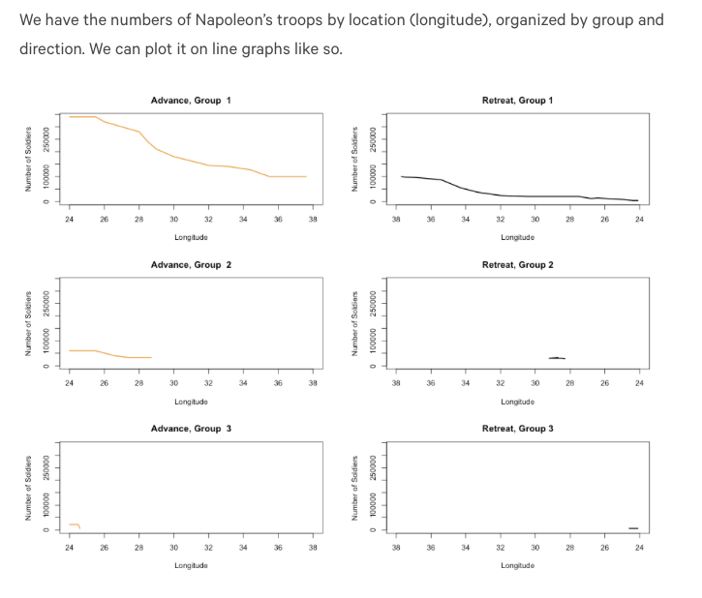

Slide 15
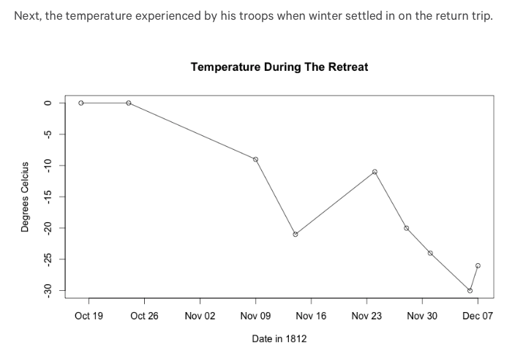

Slide 16
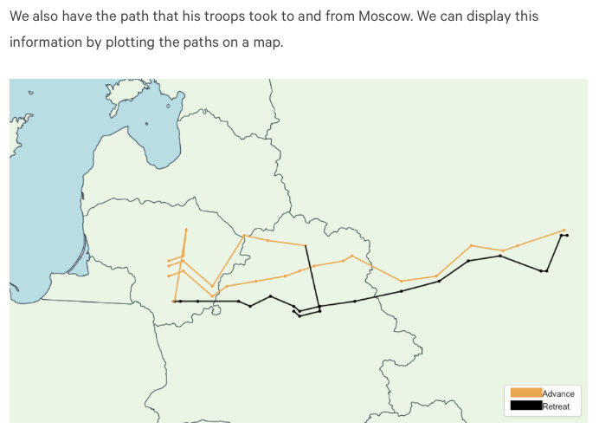

Slide 18
Why is this good? Is it good?

Slide 19
Some principles from Tufte
Use color, type, etc. wisely
Don’t assume mappings are intuitive
Be prepared for people to read into things that aren’t there
Include detailed data when possible
Leave out “chartjunk” – graphic elements that aren’t part of the content
Above all, remember the user’s purpose
Notes:
visual elements in charts and graphs that are not necessary to comprehend the information represented on the graph, or that distract the viewer from this information
Eg: Grids, distracting patterns and self-promoting graphics

Slide 20
Don’t hide detail
preserve gestalt,
but support detailed exploration

Slide 21
Eliminate
“chartjunk”

Slide 22
Consider color mappings
(or, really, consider every detail)
Notes:
from https://www.cs.uic.edu/~jbell/CourseNotes/Matlab/japan_sea.jpg
Shades of blue intuitively indicate depth of water for most humans. Rainbow color is not intuitive and requires a scale lookup every time

Slide 23
Bret Victor
Former interface designer at Apple
One of the original designers of the iPad UI
Focus on the future of interacting with information on screens

Slide 24
Victor’s Principles (interpreted)
Use the modern tools we have available
Understand and use context where we can
Data exploration tied to HCI
“Dynamic pictures”, “explorable explanations”
Check out cool demos at worrydream.com

Slide 25
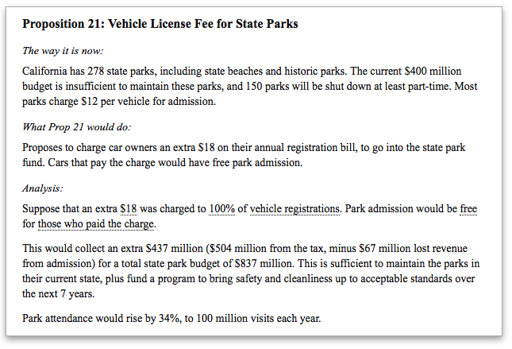
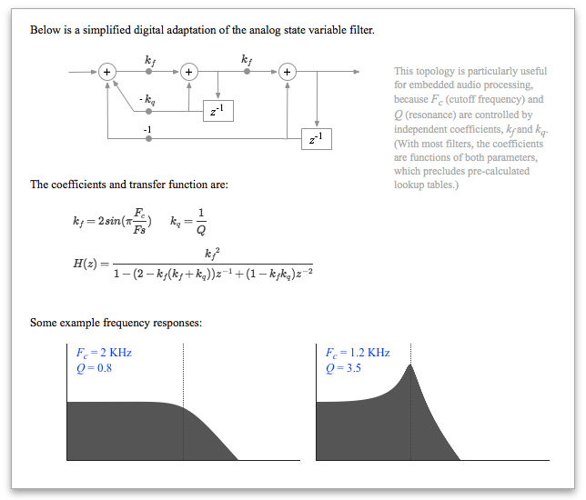
http://worrydream.com/ExplorableExplanations/
Notes:
Kind of like literate programming stuff.

Slide 26
Designing info displays

Slide 27
(Some) goals of information display
Provide an overview of the world
Allow comparisons
Show progress
Understand relationships
Motivate behavior
Test hypotheses

Slide 28
Our information design toolkit

Slide 29
Basic graphic representations
Charts
Maps
Timelines
Multiples
Photo collages
Treemaps
Sparklines

Slide 30
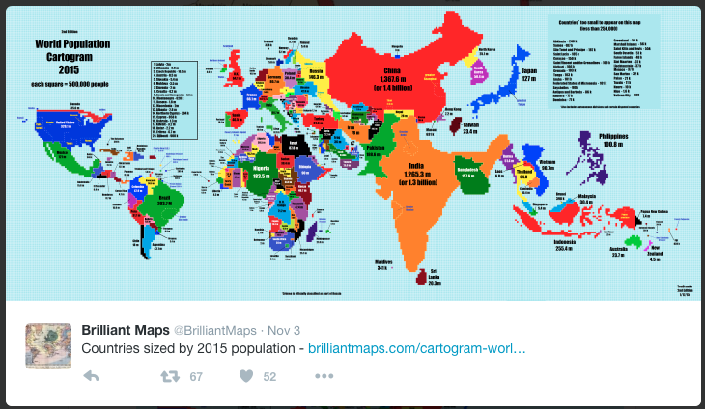
Maps
Can combine with other graphics, overlays

Slide 32
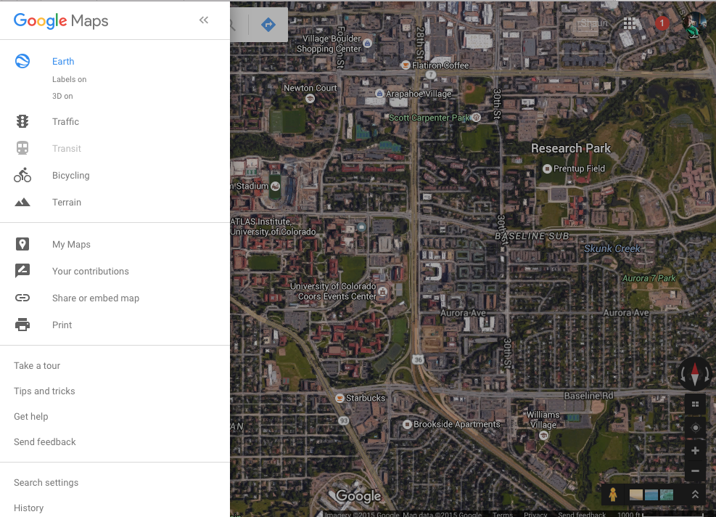
Map layering

Slide 33
Timelines

Slide 34
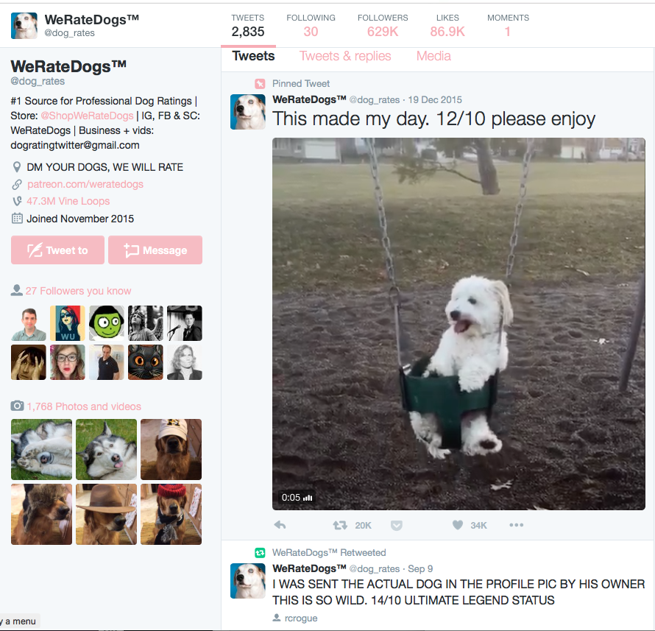
The other kind of timeline

Slide 35
Small multiples
Allow comparisons between similar data
Notes:
https://www.propublica.org/nerds/item/design-principles-for-news-apps-graphics

Slide 36
Photo collages or “image quilts”
Enable overviews of available information

Slide 37
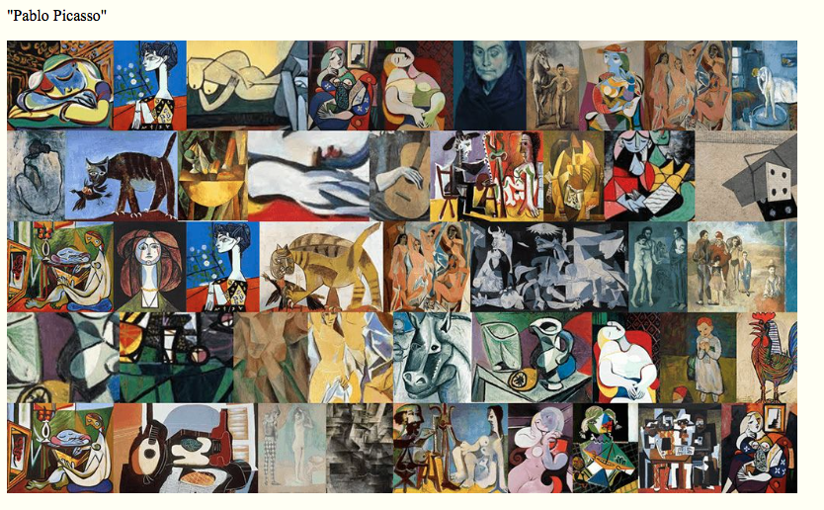
Notes:
From Tufte

Slide 38
Treemaps
Show relative importance of data in a condensed space
Invented by Prof. Ben Schneiderman, University of Maryland

Slide 40
Sparklines
Represent small quantitative data in context
Invented by Tufte

Slide 41
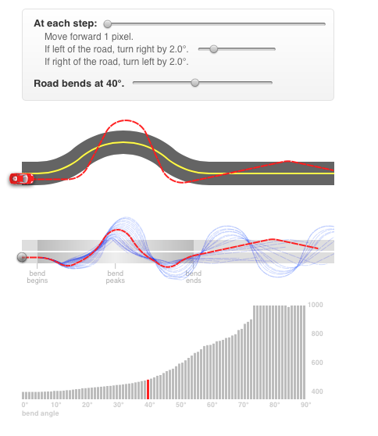
Interactive visualizations
Can limit information overload
Can enable hypothesis testing
Make interaction part of learning (rather than using it to overcome poor design)
http://worrydream.com/#!2/LadderOfAbstraction
http://phet.colorado.edu
Notes:
Blurring the line between data and UI.
Focus on learning outcome, experimentation.

Slide 42
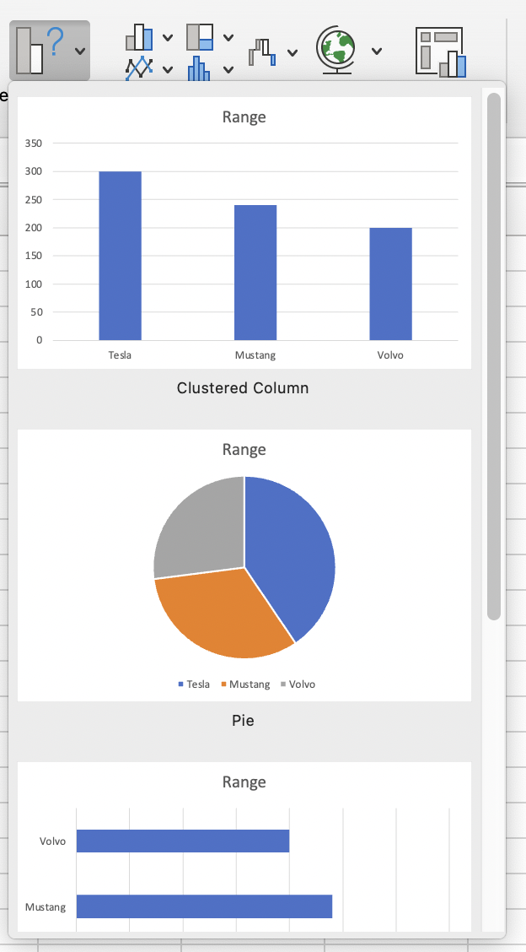
Plain old charts
Bar charts, line charts, scatter plots
What to use when?
How to choose scale?

Slide 43
Choosing scale
Must be based on the activity!
Key questions
What is the reasonable range for the activity?
What is a meaningful difference in data?
If you don’t know, it’s your job to find out
Notes:
Meaningful difference is separate from measurement precision…
Any time you work with data, you need to think critically about what it means.
This is something people get wrong all the time! Sign of a lazy designer.

Slide 44
Appropriate scale
Activity | Unit | Range (min) | Range (max) | Meaningful difference?
Weight
Walking
Calories
Savings
Note: these “common sense” values may be different in other contexts!
Notes:
For example, serious athletes probably want more precision
Setting the minimum range to zero is often the right answer… but it depends on the “shape” of the data.

Slide 45
Other details to consider
When should scale minimum be zero?
Often! (if it makes logical sense and doesn’t obscure data)
Counting rate of change vs. total?
May be useful
Log scale?
What counts as a milestone?

Slide 46
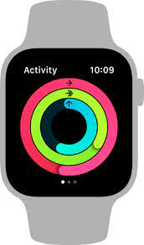

The emotional side of data
Consider what it might feel like to see data (especially about yourself)
Bad news can lead to discontinued use
Can you say something nice to the user?
Milestones are often arbitrary, can be helpful
Notes:
There’s a well known pattern with fitness trackers: people start using them, enjoy them, then fall behind on their goals, and quit using it rather than have their failure shoved in their faces every time they use it.
Closing your rings is a very successful example of gamification in design! The milestones are (somewhat) arbitrary and are automatically calculated by default. The expectation is that you can get positive feedback every day.
Images: Apple Watch from apple.com

Slide 47
Why use a certain representation?
Imagine we have data about food that a person has eaten. What would the following representations allow us to see?
Charts
Maps
Timelines
Multiples
Photo collages
Sparklines

Slide 48
Sometimes text is better
Notes:
iOS Face Dialer app

Slide 49
Non-visual representation
How to represent data non visually?
Applicable to a11y, wearables, mobile…

Slide 50
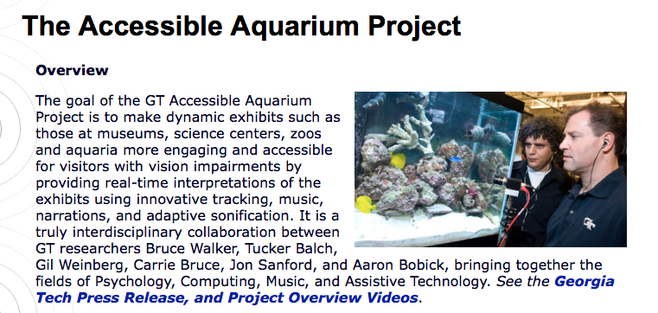
Sonification of data
Map data to pitch, stereo, other factors

Slide 51
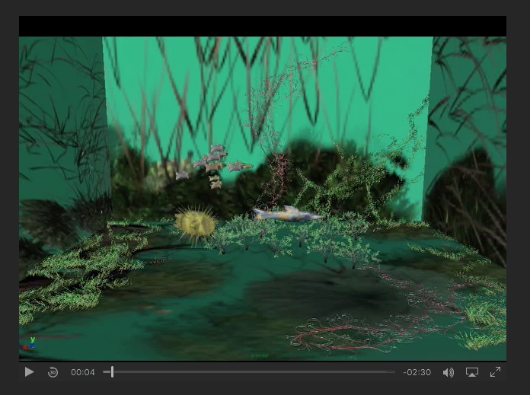
http://sonify.psych.gatech.edu/research/aquarium/
Notes:
http://sonify.psych.gatech.edu/research/aquarium/

Slide 52
Challenges of sonification
Requires training
Limited bandwidth for simultaneous transmission
Users need to learn sound mappings each time (usually)

Slide 53
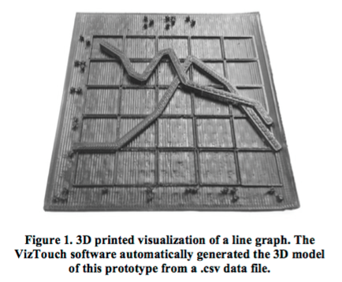
Tactile representations
Amy Hurst et al., VizTouch

Slide 54
Challenges of tactile representations
Limited sensory bandwidth
Difficult to compare across multiple points
Difficult to layer data
Most people don’t know how to design these

Slide 55
Multimodal representations
Combine visual with sound, tactile, etc.
More engineering required, but can be more universally usable

Slide 56
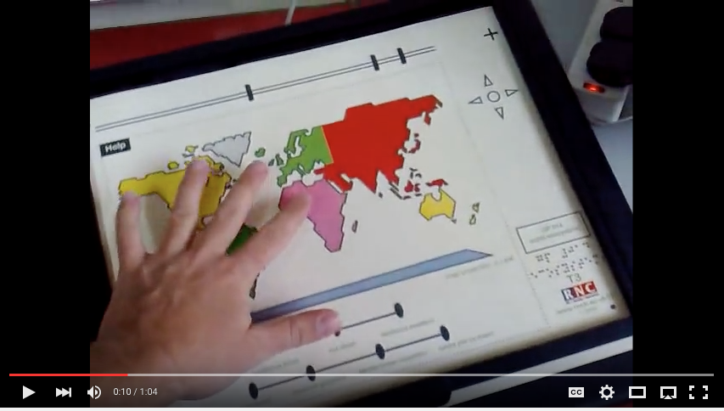
Talking Tactile Tablet
https://www.youtube.com/watch?v=MEU1XbTH1Ts
Notes:
https://www.youtube.com/watch?v=MEU1XbTH1Ts

Slide 57
Deceptive visualizations 😈
Can our information representations be misleading?

Slide 58
Lying with data
Deceiving scales
Showing data on two different scales
Spurious correlations
Ignoring important variables (e.g. scale)
Deceiving visual representation
Notes:
Examples from http://news.nationalgeographic.com/2015/06/150619-data-points-five-ways-to-lie-with-charts/

Slide 59
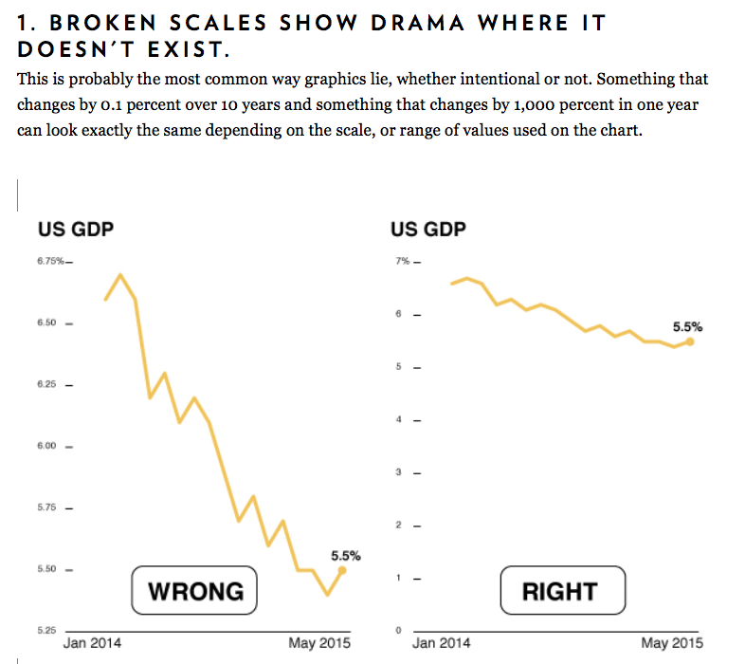
Notes:
http://news.nationalgeographic.com/2015/06/150619-data-points-five-ways-to-lie-with-charts/

Slide 60
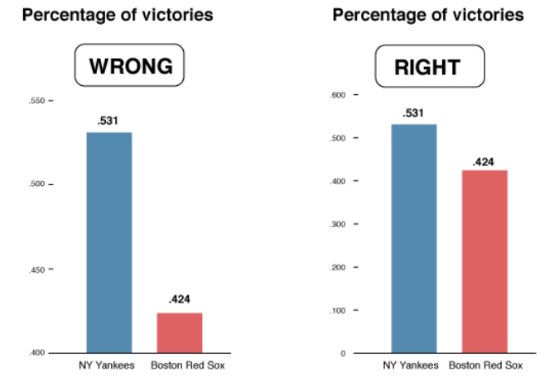

Slide 61
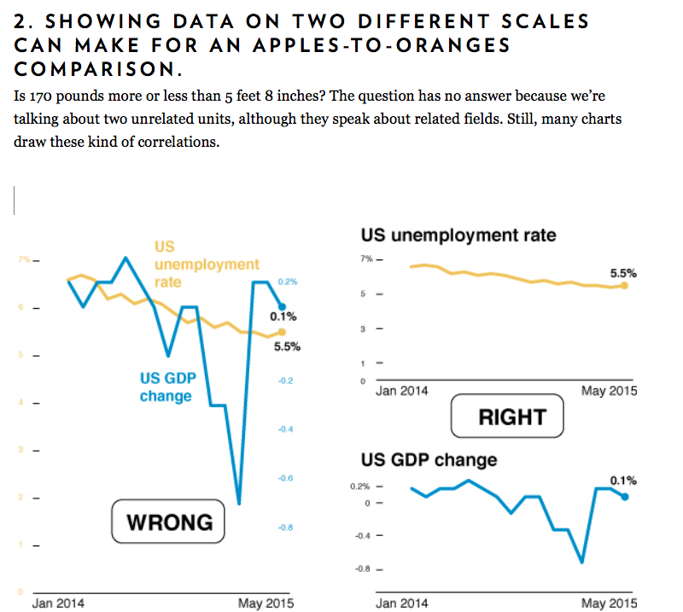

Slide 62
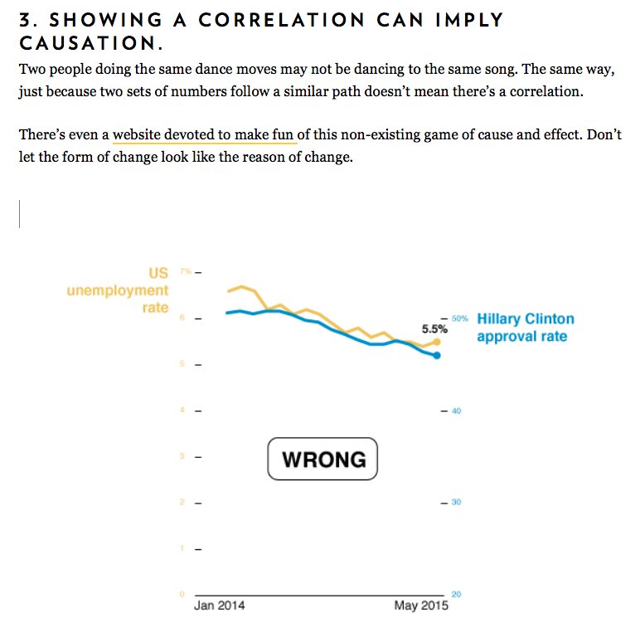

Slide 63
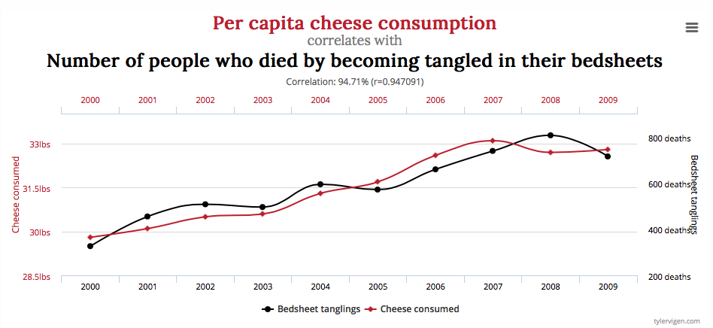
http://www.tylervigen.com/spurious-correlations

Slide 64
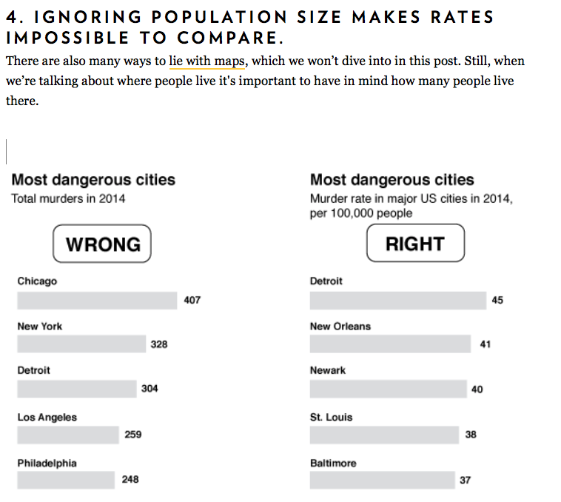

Slide 65
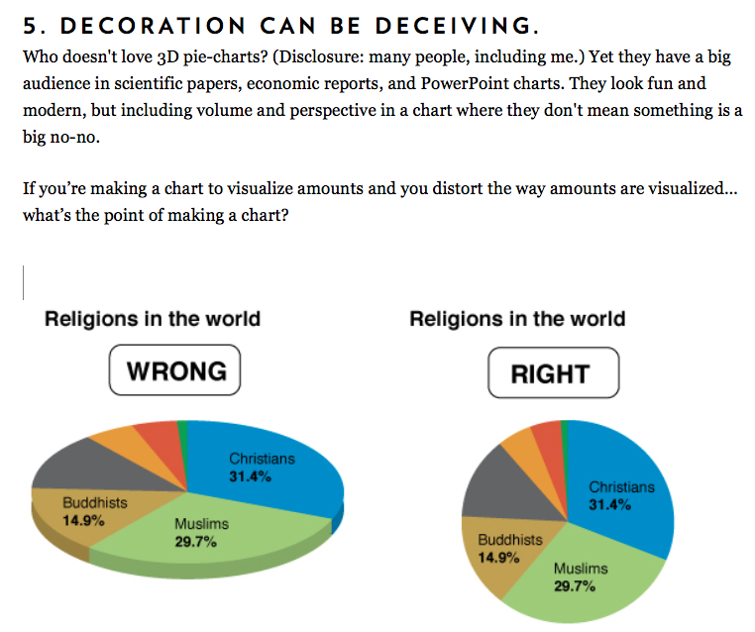

Slide 66
What to do about misleading visualizations?
Train yourself to recognize common tricks
Consider how the same information might be presented differently, and what that might show
In your work, be mindful of what your goal is (and what you want to communicate)

Slide 67
References on data representation
Edward Tufte, http://www.edwardtufte.com
Scott McCloud, Understanding Comics
http://informationisbeautiful.net
http://feltron.com/
http://reddit.com/r/DataIsBeautiful
http://reddit.com/r/DataIsUgly
http://viz.wtf

Slide 68
For next time

